Slide 1
Introduction to
Family Tree
Notes:
[Welcome]
[Introductions]
[Hymn]
[Opening prayer]

Slide 2
Agenda
Blessings and Opportunities of Family History
Family Tree
  Purpose
  Features
  Resources
Notes:
In this presentation I will be sharing some exciting things that I think will help this great work move forward. First, I will talk about some of the blessings that come from this work. Then I will introduce the Church’s new update called Family Tree.

Slide 3
Records of Your Dead
“And as are the records on the earth in relation to your dead, which are truly made out, so also are the records in heaven. This, therefore, is the sealing and binding power, and, in one sense of the word, the keys of the kingdom, which consist in the key of knowledge.”
~Doctrine and Covenants 128:14
Notes:
Section 128 is an epistle from Joseph Smith to the Church. In this verse the Prophet explains the importance of this work.
[Read verse]
[Possible discussion questions]
Why does the Prophet say “your dead” and not just the dead? How can we help Church members better understand the importance of doing temple work for their dead rather than the dead?
What do you think “truly made out” means? How can we make sure that our records are “truly made out”?

Slide 4

Blessings for You and Others
“I promise you will be protected against the intensifying influence of the adversary. As you participate in and love this holy work, you will be safeguarded in your youth and throughout your lives.”
~Elder David A. Bednar
“The Hearts of the Children Shall Turn,” Ensign, Nov. 2011, 27
Notes:
Elder Bednar in the October 2011 general conference reminded us of some of the blessings we can receive from participating in this work.
[Read quote]
I hope you have felt these blessings in your lives.

Slide 5
Why an update?
TempleReady
new FamilySearch
Family Tree
Notes:
So, why do we need an update to new FamilySearch?
The Family History Department is always striving to improve the tools they provide for doing family history. New FamilySearch (nFS) was great as a replacement for TempleReady and as a way to view data in a tree format, but it has limitations:
There are lots of obvious data errors that are difficult or impossible to fix.
It is difficult to collaborate and work together on common ancestors.
Family Tree is an update to nFS and will eventually replace nFS. Family Tree is similar in purpose to nFS and contains most of the same data, but it has upgraded functionality.

Slide 6
Data Accuracy
Editing
Sourcing
Collaboration
Notes:
Family Tree uses a better approach to organizing family history data that focuses on enhanced data accuracy through editing, collaborating, and sourcing.
By working together to improve the data over time, we'll reduce duplicates and incorrect data.
Family Tree will also be open to the public, not just Church members, so we can work together on a tree for the whole human family—we all tie back to the same ancestors, after all.

Slide 7
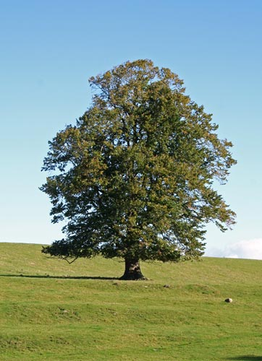
Here are seven reasons you can be excited about
Family Tree
Notes:
I will now give you seven reasons you can be excited about the Family Tree.

Slide 8
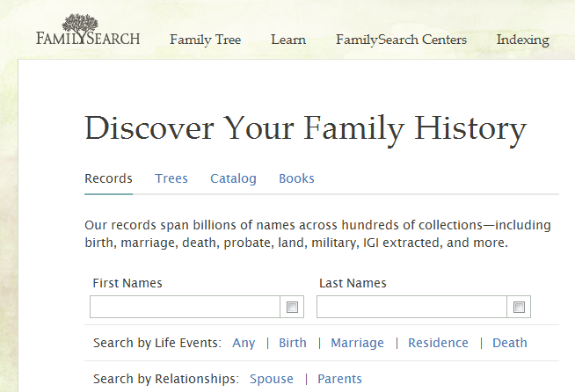
1. It's part of FamilySearch.org
Notes:
Family Tree is part of FamilySearch.org. It’s available, right here, when you sign in to FamilySearch.org. So you won’t need to use one site to search and another to record data. It is integrated into one site.

Slide 9
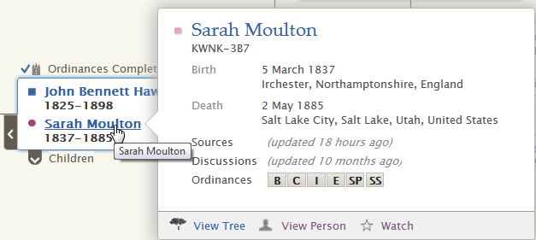
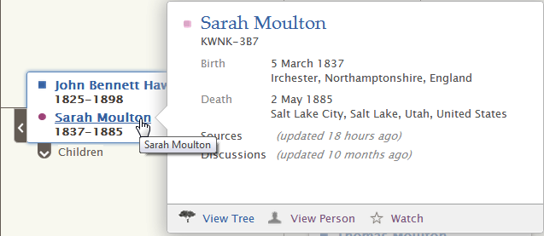
1. It's part of FamilySearch.org
Member View
With Temple Ordinances
Public View
Without Temple Ordinances
Notes:
Everyone that comes to familysearch.org will have access to Family Tree. Two types of accounts are created: a member account, using a membership record number, and a general account.
[Click]
When a member signs in to Family Tree, he or she will be able to see ordinance data.
[Click]
When a general account is used to log in, no ordinance data is shown.

Slide 10
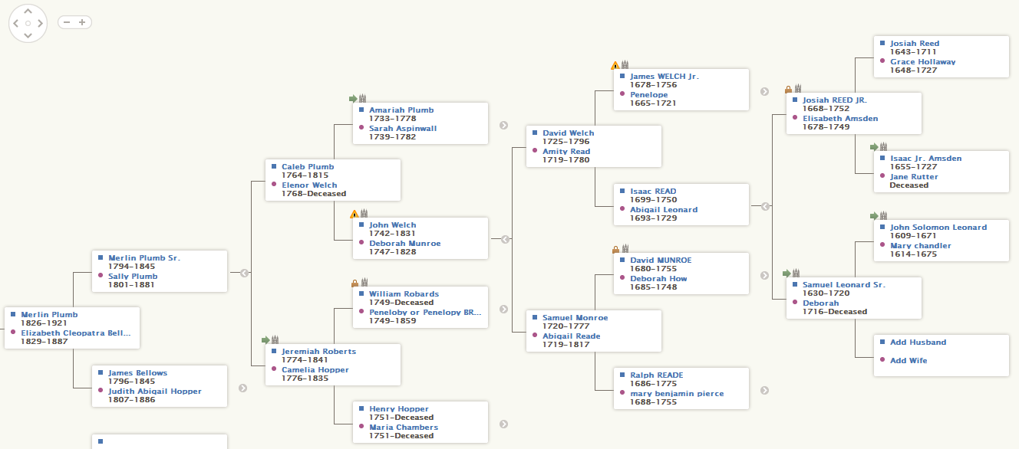
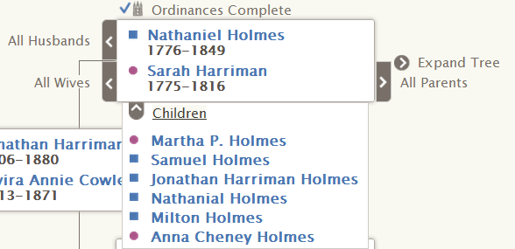
2. Get around easily
Notes:
In Family Tree you can navigate easily. You can zoom in or out, drag the content on the screen back and forth to see different parts of your family tree, and quickly expand or retract family lines.
[click]
You can see lists of children or simply click on a name to see more detailed information. You can even use the app on your tablet computer.

Slide 11

3. Edit incorrect information
I can fix
bad data!
Notes:
There has been plenty of frustration with not having the ability to change bad data in new FamilySearch. Family Tree addresses this issue by allowing you to edit data, including:
Removing a wrong relationship to a spouse, parent, or child
Deleting wrong events
Deleting wrong versions of names

Slide 12
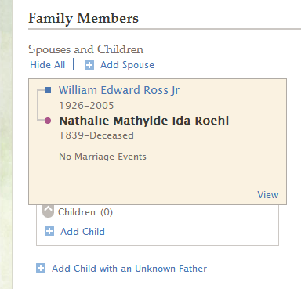
3. Edit incorrect information
Notes:
Here’s an example of how you can edit incorrect information. In this situation I know that these two individuals should not have been combined together as a couple, so I need to delete the relationship. I simply go to the Couple Relationship page by clicking View.

Slide 13
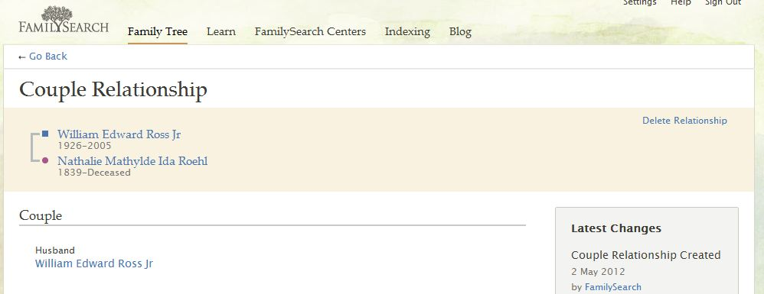
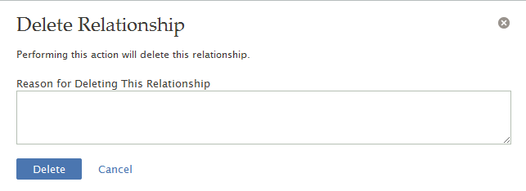
3. Edit incorrect information
These two were not a couple because they were not alive at the same time.
Notes:
On the Couple Relationship page, I click Delete Relationship. Then I will be prompted to enter a reason for deleting the relationship. Here I describe why I am taking this action so that others can see how I came to the conclusion that it was incorrect.

Slide 14
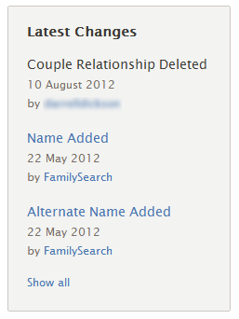
3. Edit incorrect information
Notes:
The system also keeps a change history, so you can revert back to previous information if necessary.

Slide 15

4. Link to sources
SOURCES AHEAD!
PROCEED WITH
CAUTION BEFORE
MAKING CHANGES
Notes:
Family Tree enables people to show sources and link to where the information is found. Attaching sources lets everyone see the evidence for conclusions reached and know the information is accurate. This encourages other users not to change well-documented data.

Slide 16
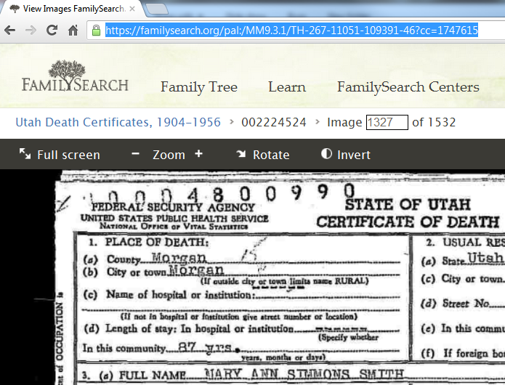

4. Link to sources
Notes:
To add a source, you simply need to provide a hyperlink to a document or website. Here I found a death certificate through familysearch.org. All I need to do is copy the URL for the document.

Slide 17
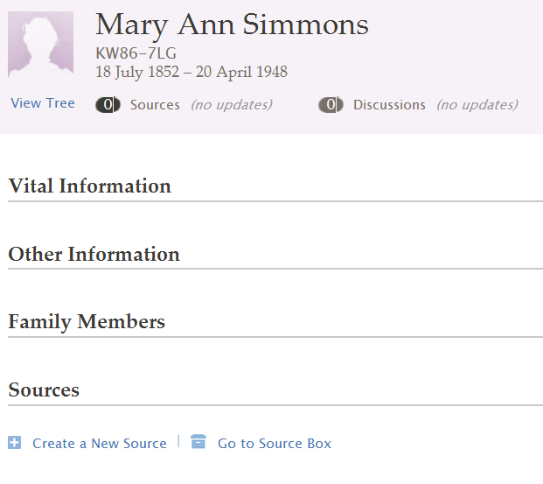
4. Link to sources
Notes:
To link to a source, go to the person’s page in Family Tree, and click Create a New Source.

Slide 18
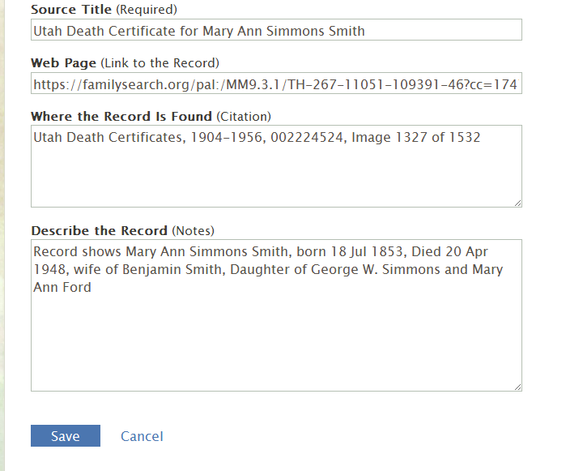

4. Link to sources
Notes:
Then you can add a source title, the hyperlink, a citation, and a description. Click Save, and then anyone else who views this person’s page can see the source.

Slide 19
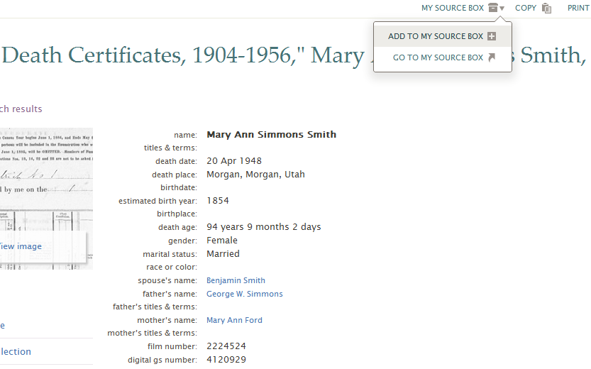
4. Link to sources
Notes:
An even easier way to add a source located on familysearch.org is to go to the source, click My Source Box, and then click Add To My Source Box.

Slide 20
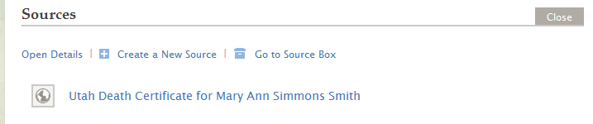
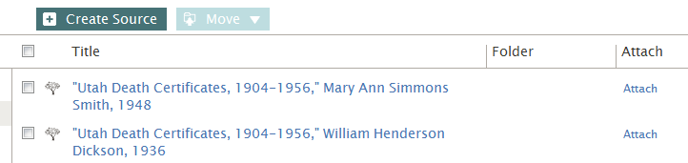
4. Link to sources
Notes:
Then, from the Person page, in the Sources section, you can click the Go to Source Box link. From your source box, you can attach the appropriate source to the person by clicking Attach.

Slide 21




5. Communicate with others
Notes:
Family Tree enables people to communicate with others.

Slide 22
5. Communicate with others
Notes:
Family Tree lets you communicate with other people who are working on your line. You can share information, compare research, and go further faster by working together. Here’s an example of a discussion page.

Slide 23

5. Communicate with others
Please encourage kindness and civility when communicating through Family Tree.
Notes:
Since we will all be working together to make Family Tree the best it can be, we should encourage everyone to keep their communication polite and to keep an attitude of cooperation–even if someone makes a change someone else doesn’t agree with.

Slide 24

6. Be notified of changes
Notes:
Family Tree helps you to stay informed of changes.

Slide 25
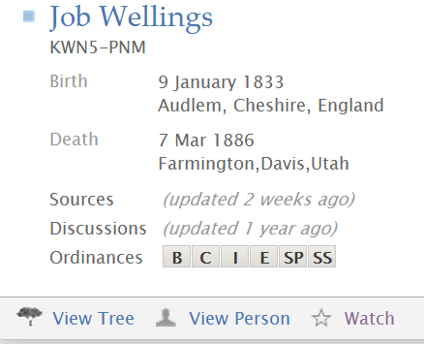
6. Be notified of changes
Notes:
You can set up alerts that notify you by e-mail when information about an ancestor you’re interested in has been changed.
To add someone to your watch list, simply click the Watch button here.

Slide 26
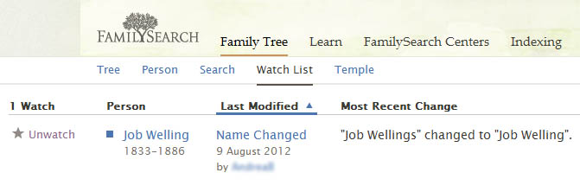
6. Be notified of changes
Notes:
You can see your watch list at any time by clicking the Watch List tab. Family Tree keeps a change history, so if someone submits inaccurate information, it’s easy to fix.

Slide 27

7. Qualify and submit names
Notes:
The main purpose of Family Tree is to help you fulfill your divinely appointed responsibility to search out your family and perform for them the sacred ordinances of the temple.

Slide 28
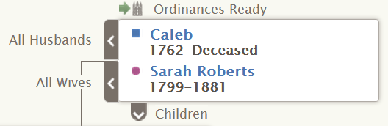
7. Qualify and submit names
Notes:
Family Tree lets you easily qualify and submit the names of ancestors for temple ordinances.

Slide 29
Resources
Training resources for Family Tree include:
Videos
Guides
Training resources are available at:
familysearch.org/treetraining
General Assistance
Phone (North America): 1-866-406-1830
Phone (international): Toll-free international phone numbers are available at contact.FamilySearch.org
E-mail: support@familysearch.org
Notes:
There are quite a few resources to help you learn Family Tree, including videos and guides. Go to familysearch.org/help to find these resources. Or if you need further assistance, you can call or e-mail the Family History Department.

